Slide 1

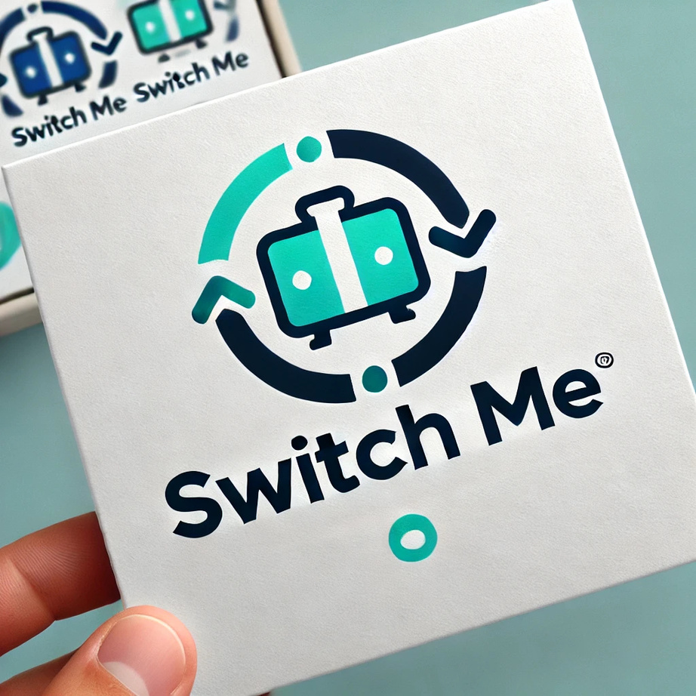

Arowwai Industries
Switch Me Platform
By: Yuval nurlian & Sahar Slavkin

Slide 2


Overview
Introduction
01
competitors review
02
literature review
03
why Switch Me
04
Functional Requirements
05
Non-Functional Requirements
06
Algorithem
07
technologies & Architecture
08
Database Structure
09
Development Stages
10

Slide 3

Introduction
The Switch Me platform is designed to enable individuals to exchange products easily, quickly, and transparently. The platform incorporates an AI mechanism for product valuation to establish a fair exchange system between users, as well as an algorithm for personalized matching of potential exchange items. This creates a unique user experience that connects people fairly and efficiently. The system offers an intuitive interface, advanced search capabilities, and the ability to manage exchanges in a simple and organized manner, emphasizing reliability and user convenience.

Slide 4

literature review
This review focuses on two main areas:
AI-Based Pricing: For transparent and fair item valuation.
Personalization algorithm in Online Commerce: To enhance user experience and enable smart product matching.
AI-Based Pricing
Personalization algorithm
AI-based algorithms analyze data and perform dynamic, real-time pricing based on demand, seasonality, and competitors. Companies like Amazon and eBay use them to enhance commerce and boost sales.
Personalization algorithms in e-commerce platforms enhance user experience by analyzing preferences and displaying relevant products based on browsing and purchase history.

Slide 5

Competitor Analysis
 | Bunz | Swap.com | Marketplace (facebook)
general description | Bunz is a Canadian platform for exchanging items, focusing on cashless transactions using an internal currency called Bunz Points. | Swap.com is an American platform for exchanging, buying, and selling second-hand items, with a focus on family-oriented products like children's clothing, toys, and books. | Facebook Marketplace is an online marketplace within Facebook that allows users to buy, sell, and exchange second-hand items easily and accessibly to a wide audience.
Disdvantages | A system based on an internal currency as a substitute for money. Absence of a price valuation mechanism. | Manual product search. Limited selection in certain categories. Physical price evaluation by sending the item to the company's warehouses | Lack of a built-in exchange mechanism. Risk of unsafe transactions due to lack of oversight. Absence of a price valuation mechanism.

Slide 6

Ecological Aspect: The project promotes sustainability by encouraging product exchange instead of buying and discarding. This allows items no longer needed to find value with others, reducing waste and conserving resources.
1
Why Switch Me
The difficulty individuals face in finding a convenient, efficient, and trustworthy platform for exchanging products without the need for purchasing or spending money.
Fair Valuation: Using an advanced AI algorithm, the platform ensures transparent and fair exchanges, saving users time and effort.
2
Personalized Matching: A smart algorithm suggests items to users based on their product's value and personal profile, providing a tailored and high-quality experience.
3

Slide 7
Functional Requirements
1
User Registration and Login: Register via email or Google API , create a personal profile with name, phone, location, gender, and date of birth, login system with password authentication.
Product Upload: Upload items with pictures, descriptions, condition, category, and preferred categories. Automatic AI-based valuation collects product details, sends them via API to a valuation mechanism, displays an estimated price range, and recommends a suggested price for better matching success.
2
3
Search and Match: Advanced search system with filters (category, condition, price range, location). Smart matching based on algorithms that consider search history, preferred categories, age, gender, and other relevant factors
4
Rating and Reviews: Users can rate products and completed swaps, with reviews displayed for users and products.
Swap Process: Transaction management system to review transaction details, option to accept or reject swap offers, ability for users to communicate to arrange swap details.
5
Admin Interface: Removal of inappropriate products, blocking users who violate terms of service or engage in fraudulent activities, and monitoring platform usage data, including swap statistics, product uploads, and active users.
6

Slide 8
Non-Functional Requirements
1
Performance: Average response time of up to 3 seconds for standard actions and up to 9 seconds for complex actions, real-time updates in less than 2 seconds. Support for up to 100,000 active users simultaneously without performance degradation. During the initial pilot phase, the platform will allow a limited number of users on a local computer.
2
Security: Personal data storage with password protection, implementation of Google's secure API protocols for authentication and encrypted data transmission.
3
Reliability: The platform should maintain 99% availability, excluding scheduled maintenance.
Usability: the platform will be web-only initially with potential for a mobile version based on demand. The design will prioritize a user-friendly and intuitive experience, ensuring simplicity and quick access to all core functionalities, making the platform clear and easy to use.
4
Maintainability: The codebase will be designed modularly to allow easy updates and enhancements without downtime, the system will log user activities and generate automated activity reports to improve performance, the platform will include clear policies for administrative actions such as blocking users and removing inappropriate items, the system will be designed to scale easily to support a larger number of users and items.
5

Slide 9

technologies & Architecture
Backend:
Database: PostgreSQL (using pgAdmin4).
Programming Language: The backend will be developed using either C# or Java.
Functionality:
Handles business logic, user authentication, and data processing.
Provides APIs for communication with the frontend and integration with AI mechanisms.
Frontend:
Frameworks: Angular and Node.js for dynamic and efficient development.
Technologies:
HTML and CSS for structuring and styling the application.
TypeScript for scalable code.
Functionality:
Delivers an intuitive and responsive user interface.
Communicates with the backend through RESTful APIs.
Additional Features:
AI Integration:
The system will include APIs to integrate various AI mechanisms, such as automatic
product valuation, intelligent matching algorithms, and real-time notifications

Slide 10
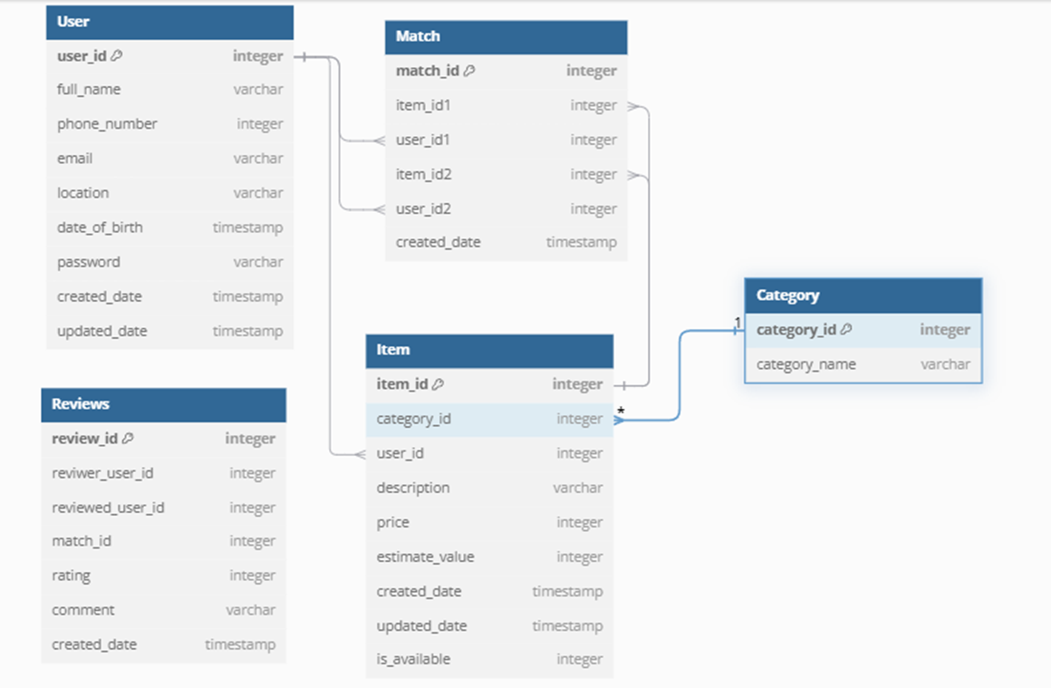
Database Structure

Slide 11


DEVELOPMENT STAGES
Planning and Design
Backend Development
Frontend Development
Testing and Integration
Launch and Documentation
- Writing a detailed specification for the platform.
- Creating UX/UI documentation.
-Establishing infrastructure for the project, including a connection to the frontend
- Setting up the database using MySQL/Oracle.
- Developing APIs for user, product, and exchange management.
- Building an AI-powered API for price evaluation.
- Implementing user authentication.
- Creating the user interface using Angular.
- Developing forms for adding/editing products.
- Connecting to APIs for real-time data retrieval.
- Product viewing modes Table view with filters + single product view mode
- Performing unit tests and integration tests for all modules.
- Fixing bugs and improving system performance.
- Conducting user experience (UX) testing.
- Fully integrating the frontend, backend, and AI price evaluation API.
- Preparing the first version of the platform for launch.
- Presenting the project with a live demonstration.
- Gathering feedback for future improvements.

Slide 12


THANK YOU!

Slide 13
1. Specification
The specification phase includes defining the project's objectives, identifying user needs, and describing the functional and non-functional requirements.
2. Mockups
Creating relevant screens such as a user login screen, a product upload screen, a product viewing screen, a platform admin screen, and more.
3. Back-End + Front-End
The back-end phase includes developing business logic, managing the database, and integrating AI technologies for item valuation and smart matching. Additionally, APIs are built for communication with the front-end, with a focus on data security and fast user response.
4. Mockups
Creating relevant screens such as a user login screen, a product upload screen, a product viewing screen, a platform admin screen, and more.

Slide 14
Competitor Analysis
 | Bunz | Swap.com | Marketplace (facebook)
general description | Bunz is a Canadian platform for exchanging items, focusing on cashless transactions using an internal currency called Bunz Points. | Swap.com is an American platform for exchanging, buying, and selling second-hand items, with a focus on family-oriented products like children's clothing, toys, and books. | Facebook Marketplace is an online marketplace within Facebook that allows users to buy, sell, and exchange second-hand items easily and accessibly to a wide audience.
Disdvantages | A system based on an internal currency as a substitute for money. Absence of a price valuation mechanism. | Manual product search. Limited selection in certain categories. Physical price evaluation by sending the item to the company's warehouses | Lack of a built-in exchange mechanism. Risk of unsafe transactions due to lack of oversight. Absence of a price valuation mechanism.

Slide 15





Our Team
Aaron Loeb
Alfredo Torres
Juliana Silva
Daniel Gallego
Olivia Wilson
CEO & Founder
Project manager
CEO & Founder
IT Expert
Marketing Head

